Slide 1


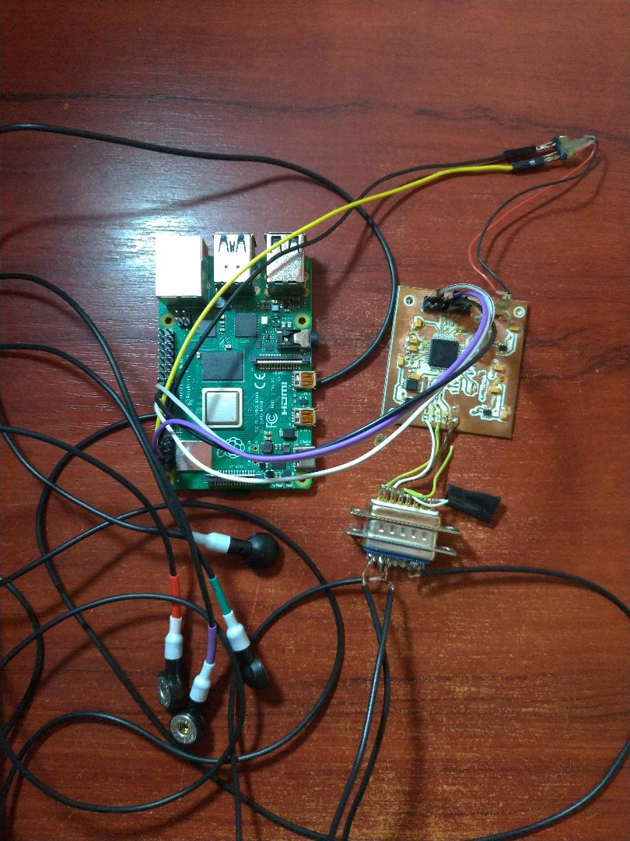
Real-time ECG and respiratory signals monitoring and interpretation using AI
Author:Iancu Daniel
Introduction
Conclusions
Prototype
Increasing number of people bound to hospital bed ->necessity for portability
Number 1 cause of mortality
No human needed for interpretation -> homecare
Combining both respiratory and EKG signals for better overall health monitoring
BONUS: Emotion detection based on these signals
Interpeter for both respiratory and ECG signals
Open source code for faster improvements
Many interfacing options
Integration into cloud servers
Motivation and Description of Work
References
https://www.researchgate.net/publication/267097869_An_Affordable_ECG_and_Respiration_Monitoring_System_Based_on_Raspberry_PI_and_ADAS1000_First_Step_towards_Homecare_Applications
•ADAS1000 is used for the acquisition of signals.
• The information is sent via SPI to Rpi where the processing part takes place.
• After obtaining the ECG and respiratory values the system seeks to fulfill the following requirements:
-live plotting UIR
-ECG interpretation and emotion detection using machine-learning algorithms/classifiers32
Targul International de Inventii si Idei Practice Invent – Invest Constantin-Marin Antohi, editia 12- a, Iasi, Romania

