Slide 1
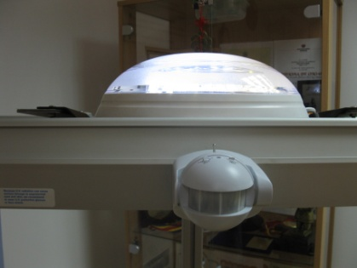
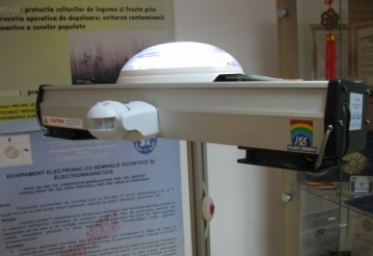
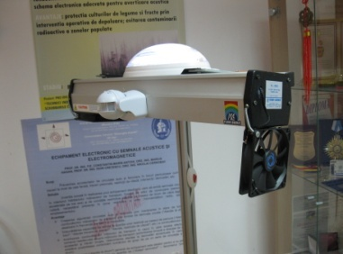
AIR DISINFECTION INSTALLATION IN REVERSE CURRENT
OSIM REGISTRATION FILE NO. A 00649/10.09.2012
Authors: Prof. Dr. NORINA CONSUELA FORNA, Prof. Dr. CONSTANTIN MARIN ANTOHI
Introduction
Results
Conclusions
PURPOSE:
It refers to an installation for the air disinfection from rooms where human activities are performed, food storages and especially medical units, libraries, archives, etc. using the C type ultraviolet radiation.
In order to reduce the time allocated for the disinfection of the room, the air collection is done from different directions through the rotation of the installation horizontally due to an electric diagram proposed in a usage variant.
The effect of the use of the reverse current solution is the increase of the efficiency of the disinfection;
It creates a double UV protection through the motion sensor and the remote controlled switch plug;
Reduction of the functioning duration of the installation for attaining the desired air disinfection degree;
It creates a rapid protection against several infections of the personnel that performs its activity or the public present in different locations;
It keeps functioning even if there is no voltage in the 220V electric network.
Motivation and Description of Work
The air disinfection installation in reverse current is made up of 2 UV-C radiation generators set up at a R/2 distance from the top of a semi-cylindrical mirror in order to create a parallel radiation beam. For the protection of the people, a motion sensor is used and a remote controlled switch plug.
STAGE: Prototype
Targul International de Inventii si Idei Practice Invent – Invest Constantin-Marin Antohi, editia 12- a, Iasi, Romania

