Slide 1
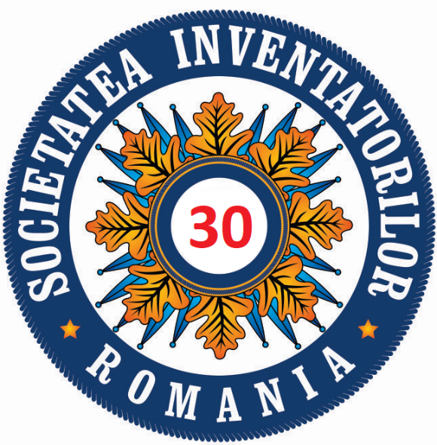
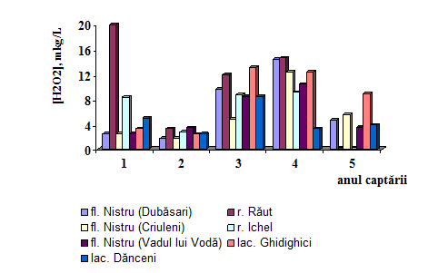
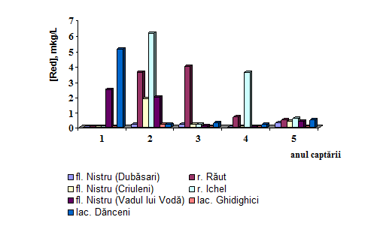
REDOX SELF-PURIFICATION PROCESSES OF NATURAL WATERS
Duca Gheorghe*, Gladchi Viorica, Bunduchi Elena, Blonschi Vladislav
Moldova State University ,
*Corresponding author's e-mail address: ggduca@gmail.com
Introduction
Results
Conclusions
The oxygen biogeochemical cycle (OBC) in natural waters is of great importance in water self-purification processes. The water self-purification capacity can be assessed measuring the concentration of different OBC components. Thus, in this work the concentrations of some OBC components, H₂O₂ and the reducing compounds oxidized by H₂O₂ (Red) were determinated.
The monitored objects were Nistru River, in the Dubasari-Vadul lui Voda dam segment, its tributaries, Raut and Ichel, at the mouths of confluence with the river, and the Ghidighici and Danceni lakes.
Water monitoring for the period 2015-2019 revealed the following. The average annual values for the Nistru River show the minimum H₂O₂ value of 1.7 μg/L and the maximum of 14.5 μg/L ; 0 and 20 μg/L for the Bâc River and 0 and 9.2 μg/L for those of the Ichel River; 2.4-13.2 and 2.5-8.5 μg/L for the Ghidighici and Danceni lake respectively (fig.1). The peroxide concentrations were frequently closer to the lower limit of this oxidant in natural waters (10-100 μg/L ), showing a constant and high H₂O₂ consumption in self-purification of these natural waters.
In the rivers and tributaries waters the reducing compounds (Red) are detected from 2016: 1.7-2.5 μg/L in the Nistru River; 3.4 μg/L – Răut River and 2.8 μg/L – Ichel River. Subsequently, the detected concentration was decreased. In the Ghidighici lake the reducing compounds was only once detected in 2016 (0.2 μg/L ), while in Danceni lake waters during the entire monitoring period (fig. 2).
Both the individual and the annual average values shows low concentration (about 10 μg/L ) or lack of H₂O₂ in all analyzed waters, proving a constant H₂O₂ consumption in self-purification processes of the in natural waters, the oxidized substances content by H₂O₂ was frequently high.
References
Motivation and Description of Work
The considerable development of the industry in the last decades has a decisive impact on the environment, especially on natural waters. Correct estimation of the ecological status of aquatic objects requires the use of a wide range of specific ecochemical methods, such as kinetic ones. Thus, the determination of oxidative equivalents, which are products of the activation of dissolved oxygen, can provide an immediate answer to the ecological status of natural waters. Based on the concentration determined by hydrogen peroxide, the parameter redox state can be evaluated, which in the absence of pollution must indicate the dominance of the oxidative equivalents. Thus, the determination of the redox status parameter can be useful in other fields than ecological chemistry and environmental protection - when assessing the ecological status of some aquatic objects of major importance, such as fish farming. Thus, monitoring the redox status is essential in the early stages of fish fry growth.
[1] DUCA, Gh., TRAVIN, S. Reaction’s mechanisms and applications of hydrogen peroxide. In: American Journal of Physical Chemistry. 2020, Vol. 9, N. 2, pp. 36-44
Fig.1. Annual averages of H₂O₂ content.
1 - 2015; 2 - 2016; 3 - 2017; 4 - 2018; 5 – 2019
Fig.2. Annual averages of the reducing compounds content.
1 - 2015; 2 - 2016; 3 - 2017; 4 - 2018; 5 – 2019.
Targul International de Inventii si Idei Practice Invent – Invest Constantin-Marin Antohi, editia 12- a, Iasi, Romania

