Slide 1
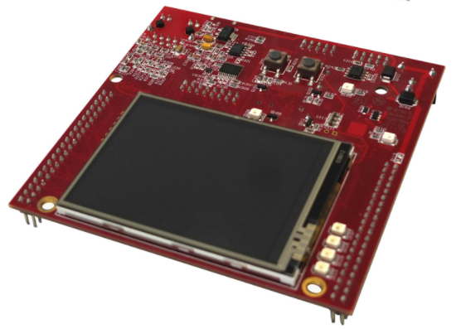
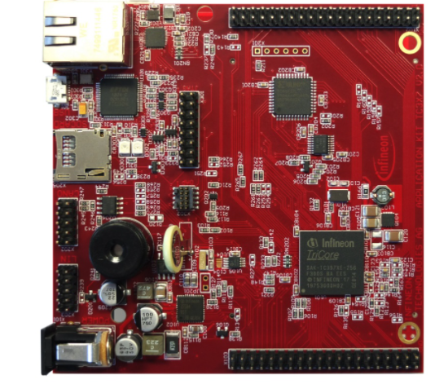
Idea Authors Șutac Tudor Cojocariu Andrei
tudor.sutac@student.tuiasi.ro andrei.cojocariu@student.tuiasi.ro
Introduction
Mission
This idea can be use for a secure communication between smart devices, for example, the front door and the windows or the fridge and the cooker.
This controller offers a variety of sensors which can be integrated to collect more data to secure analyze the parameters of your house.
The idea of a secured way to transmit data using 2 Aurix controllers that exchange CAN FD messages that are encrypted using RSA and the integrity of the message is verified using MAC algorithms.
With AES algorithm local stored data of each controller can be protected from external threats.
Motivation and Description of Work
Conclusions
Security communication threats are more and more common. The protection of the data become really important nowadays.
This idea can be used in every Smart Home where it is possible to connect many unsecured IoT devices.
We chose 2 Aurix controllers, one to be placed outside of the house and the second one to be connected inside the house.
Nowadays everybody should be aware and careful to the privacy and security of his data, that is why the encryption algorithms are very important. No one want the data from his house to be available for external threats.
We think that using two different encryption algorithms the complexity of security increases.
CAN FD is a fast and flexible method to transmit messages between controllers
We successfully implemented the CAN FD and we shared some correct messages and the implementation of the AES and RSA algorithms are working properly as we expected.
This idea bring more safety and security in communication between IoT devices.
RSA and AES algorithms prove there efficiency over time and they are used in many IoT application and cryptography applications.
Targul International de Inventii si Idei Practice Invent – Invest Constantin-Marin Antohi, editia 12- a, Iasi, Romania

