Slide 1
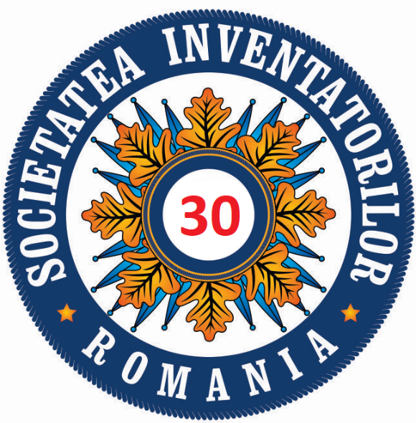
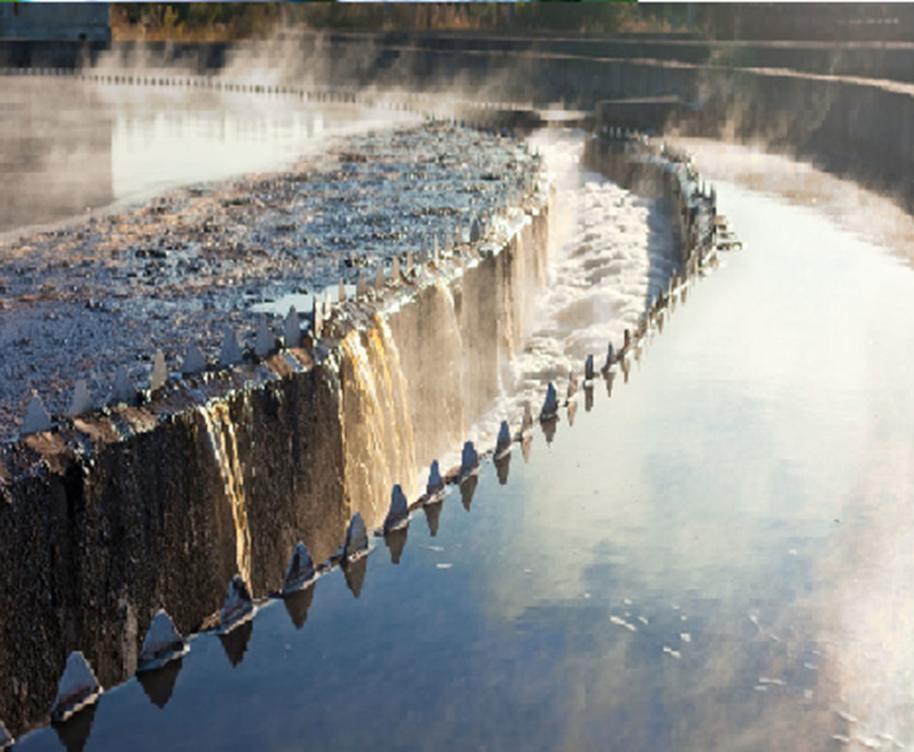
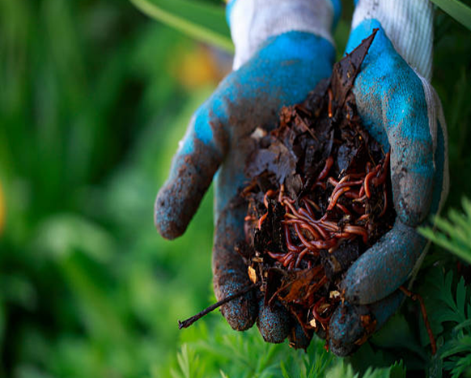
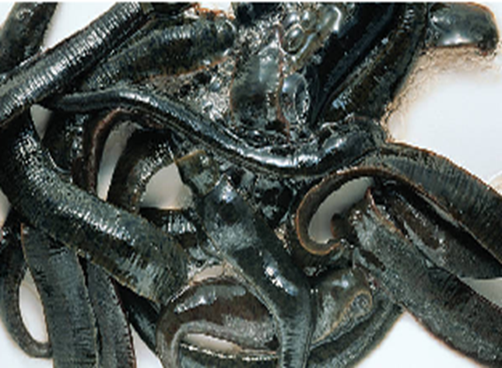
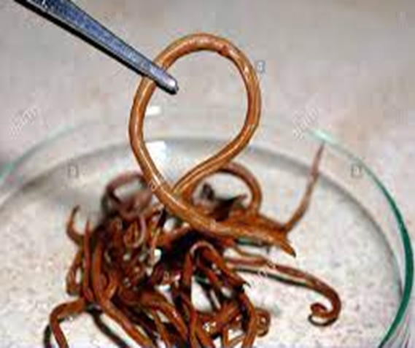
SEWAGE SLUDGE DEWORMING METHOD
Acad. Gheorghe Duca, Dr. Victor Covaliov, Dr. Hab. Olga Covaliova, Dr. Dumitru Ungureanu, Dr. Natalia Ciobanu, Dr. Lidia Romanciuc
Institute of Chemistry, Republic of Moldova, covaleva.olga@yahoo.com
Patent Appl. MD Nr. 0077/2020, Positive Decision on Patent Awarding AGEPI Nr.9881 of 2021-09-23
Introduction
Results
Conclusions
Currently, the wastewater treatment sludge, containing hundreds and thousands of helminths eggs per 1 m³, are, as a rule, not subjected to detoxication / disinfestation treatment. Processing of such sludge usually consists in the sludge maintaining on the sludge beds for a long time - up to 4-5 years, depending on climatic conditions, which reduces the utilization rate of sludge beds and, ultimately, requires huge areas of land.
Different methods of sewage sludge deworming have been elaborated so far, such as: sludge drying on the sludge beds, artificial sludge dewatering with separate disinfestation of liquid and solid fraction with application of 0,2-2,0% thiazone solution. However, practically all the methods proposed have not been practically applied, due to the difficulties in operation, high costs, insufficient efficiency, etc. Therefore, the problem of helminths-polluted sewage sludge management and safe application in practice remains to be among the important unresolved issues, and needs to be properly addressed.
A new environmentally-friendly sewage sludge deworming agent was proposed, containing the solution of ovicidal substances of natural origin with strong antibacterial and antiseptic properties with pesticide action against worms and numerous microorganisms.
The proposed invention is related to the field of sanitary helminthology and the water treatment sludge deworming agent can be applied by the communal services, in agriculture, to ensure the detoxication / disinfestation of wastewaters and sludge polluted with the helminths eggs. The deworming agent proposed is cheap, being based on the easily available local vegetable source.
Its application does not need any costly technical devices, it is easy-to-use and can be used at wastewater treatment plants of any capacity.
High rate and efficiency of deworming helps to resolve the problem of further using of treated sludge, which may be used as a fertilizer for technical crops, flower beds, forest trees nurseries, decorative trees and bushes, etc.
Application of the sludge deworming agent involves its mixing with treated sludge in doses of 0.1-0.5 g/dm³ sludge.
The exposure of helminths eggs for
6-8 hours, under the anaerobic stabilization conditions, has demonstrated the high sludge desinfection efficiency, reaching 97-100% of helminths eggs destroyed.
The deworming agent proposed can be applied at wastewater treatment plants, as well as in the fields of communal services and agriculture, especially for the desinfection of sewerage sludge and wastes containing the helminths eggs.
Motivation and Description of Work
The scope of this work was reducing the costs and improving the efficiency and fiability of wastewater sewage sludge deworming, in order to protect the environment and use the sludge as organo-mineral fertilizer for technical crops.
Targul International de Inventii si Idei Practice Invent – Invest Constantin-Marin Antohi, editia 12- a, Iasi, Romania

