Slide 1
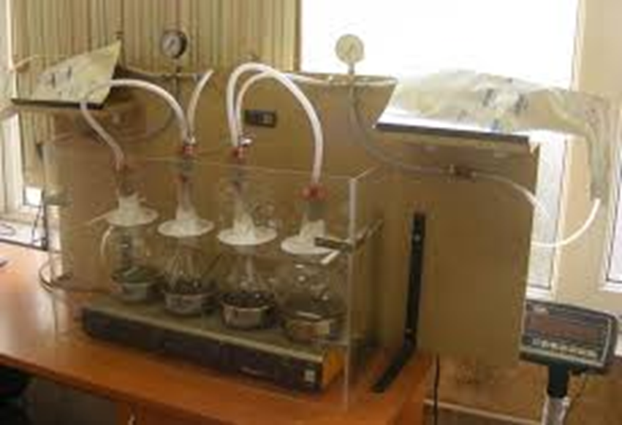
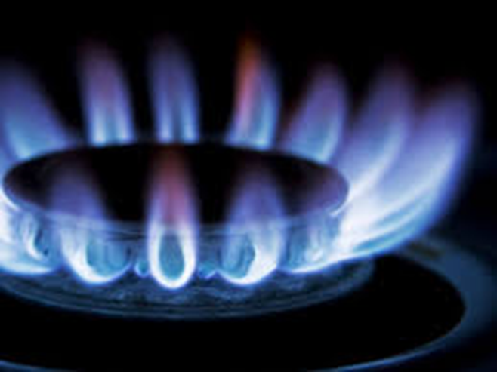
HIGH CALORICITY BIOGAS PRODUCTION FROM
BROAD NOMENCLATURE OF BIOMASS
Patent MD Nr. 4767 of 2021-09-30
Acad.Gh.Duca, Dr.Victor Covaliov, Dr.hab.Olga Covaliova, Dr.Lidia Romanciuc
Institute of Chemistry, Republic of Moldova, covaleva.olga@yahoo.com
Introduction
Results
Conclusions
The biogas production processes based on the methanogenic digestion of organic materials / wastes are known and applied on a broad scale. However, in spite of the rather broad practical application of this process, there are still some impediments which prevent production of high caloricity biogas under the economic conditions. Thus, there are different types of waste biomass that are poorly subjected to anaerobic digestion, such as cellulose-containing materials, post-distillery vinasse, although these wastes are formed in large amounts and often are just damped into the landfills or soil. Another problem is insufficiently intensive digestion, which makes the biogas production process long-term in some cases. It has been found, however, that introduction into the digesting biomass of some quantities of hydrogen may help to intensify the digestion rate. Electrolytic hydrogen is rather costly and ins introduction into the biomass makes the biogas production process energy-consuming.
The technology proposed is intended to resolve several problems: 1) to use broader nomenclature of biomass for biogas production, 2) to prevent damping into the landfills of poorly-digesting cellulose-containing wastes formed in large amounts, 3) to make biogas production process intensive due to introduction of hydrogen and smaller amounts of adjacent gases, 4) to enhance biomethane contents in biogas up to 95% and higher, to make it comparable by caloricity with natural gas used for auto-transport, heating, or other scopes..
A novel technology has been elaborated and tested for ther biogas production, which is based on anaerobic methanogenic digestion of vinasse biomass resulted from alcohol distillation. The process involves passing through the biomass of gas mixture formed during the catalytic gasification of cellulose-containing wastes.
The gas mixture applied contains hydrogen, carbon monoxide and dioxide and methane in the following ratio: 1:0.9:0.45:0.013, being dosed in the digested biomass in amounts of 0.05-0.1 dm3/L vinasse.
The process proposed allows obtaining of high caloricity biogas (95-97% methane), which is close to the composition of natural gas, from broad spectrum of organic agricultural wastes.
For the digestion within the integrated especially designed reactor, both liquid and solid biomass can be used, that prevents their throwing and discharges into the natural environment.
As a raw material for biogas production, broad nomenclature of initial biomass can be used including the organic wastes from distillery and wine production processes, poultry and cattle farms, food wastes and cellulose-containing material from wood processing, autumn leaves, chips of vine, etc.
For the gasification of cellulose-containing wastes the raw material is used including the fragmented pieces of vine or dry wood, autumn leaves, whereas gasification is running within atmosphere of oxygen-enriched air under 400-500°С. As a catalyst for gasification of cellulose-containing organic wastes, hard to biodegrade, the granular magnetite particles (Fe3O4) are applied. This is the first step of the proposed process.
The second step implies the dosing of generator gas into the bioreactor decreases the lag-phase of biochemical process, thus substantially promoting the intensive biogas emission, accelerating the biomass digestion rate and increasing the methane contents in it.
Motivation and Description of Work
Increasing the biogas caloric value through the enhancing of biomethane contents in its composition, as well as enlarging of the nomenclature of the fermented solid and liquid organic wastes.
Targul International de Inventii si Idei Practice Invent – Invest Constantin-Marin Antohi, editia 12- a, Iasi, Romania

